Slide 1
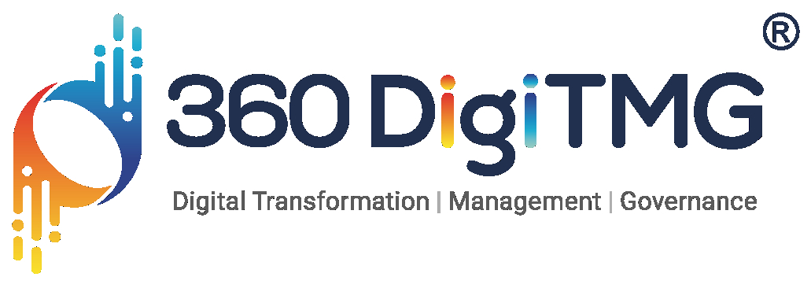

Demand forecasting and production optimization
Demand forecasting and production optimization are important for businesses to improve operational efficiency, reduce costs, and meet customer needs
Demand forecasting :
Predicts future demand for a product or service to help businesses plan production and inventory levels. Accurate demand forecasting helps businesses avoid overproduction and underproduction, and can lead to improved customer satisfaction.
Production optimization :
Involves defining production system components, collecting and analyzing data, and building a mathematical model of the production system. The model can be used to simulate different scenarios and optimize decisions.

Slide 2

Project Leadership
Bhupendra Dewangan
Data Scientist-Cum-Trainer at AISPRY
https://www.linkedin.com/in/bhupendra-dewangan-7b2630247?utm_source=share&utm_campaign=share_via&utm_content=profile&utm_medium=android_app
Bhupendra Dewangan is a passionate data scientist with expertise in machine learning, artificial intelligence, statistics, and mathematics. He is skilled at transforming data into actionable insights and leveraging advanced AI techniques to solve complex problems. He has a deep understanding of statistical methods and applies advanced mathematical techniques to build robust data models. Bhupendra is a certified Tableau Desktop Specialist, excelling in data visualization and storytelling. His mission is to help organizations make informed decisions and stay competitive through innovative data-driven solutions.
Project Coordinator:
1. Pitabas

Slide 3
Name : Kaushiv Chaudhary
LinkdIn : linkedin.com/in/kaushivchaudhary

Slide 4
Project Overview and Scope
Demand forecasting involves predicting future customer demand using historical data and analytical models. Accurate demand forecasts are critical for making informed business decisions, including inventory management, production planning, and financial forecasting. Demand forecasting typically relies on statistical methods (like moving averages, exponential smoothing, ARIMA), machine learning models, or a combination of both.
Production optimization focuses on maximizing production efficiency, minimizing costs, and meeting demand requirements. It involves making decisions on resource allocation, production schedules, inventory levels, and capacity planning, often based on demand forecasts. The goal is to strike a balance between supply and demand while minimizing waste and maximizing profitability.
Data Collection & Analysis:
Gather historical sales, inventory, and external factors like economic indicators.
Analyze patterns, trends, and seasonality in the data.
Forecasting Models:
Time series models (e.g., ARIMA, SARIMA).
Machine learning models (e.g., Random Forest, Gradient Boosting, Neural Networks).
Hybrid models combining statistical and machine learning techniques.
Optimization Techniques:
Linear/Nonlinear programming to minimize costs (e.g., transportation, storage, production).
Heuristic algorithms (e.g., Genetic Algorithms, Particle Swarm Optimization) for complex systems.
Simulation techniques to handle uncertainty in production processes.

Slide 5
Contents
Business Objective
Business Constraints
Project Architecture
Data Collection
Exploratory Data Analysis
Data Visualization
Notes:
Change

Slide 6

Business Problem
The existing forecasting technique for the client is not effective. The project aims to forecast demand for construction machinery variants to optimize manufacturing and distribution.

Slide 7
Business Objective
Objective
Constraints
Maximize operational efficiency and responsiveness. Minimize stockouts and inventory imbalances.

Slide 8
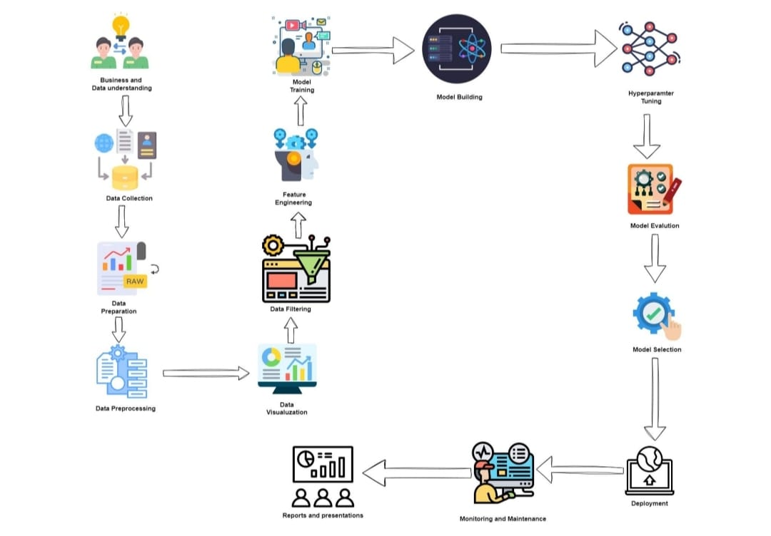
Project Architecture

Slide 9
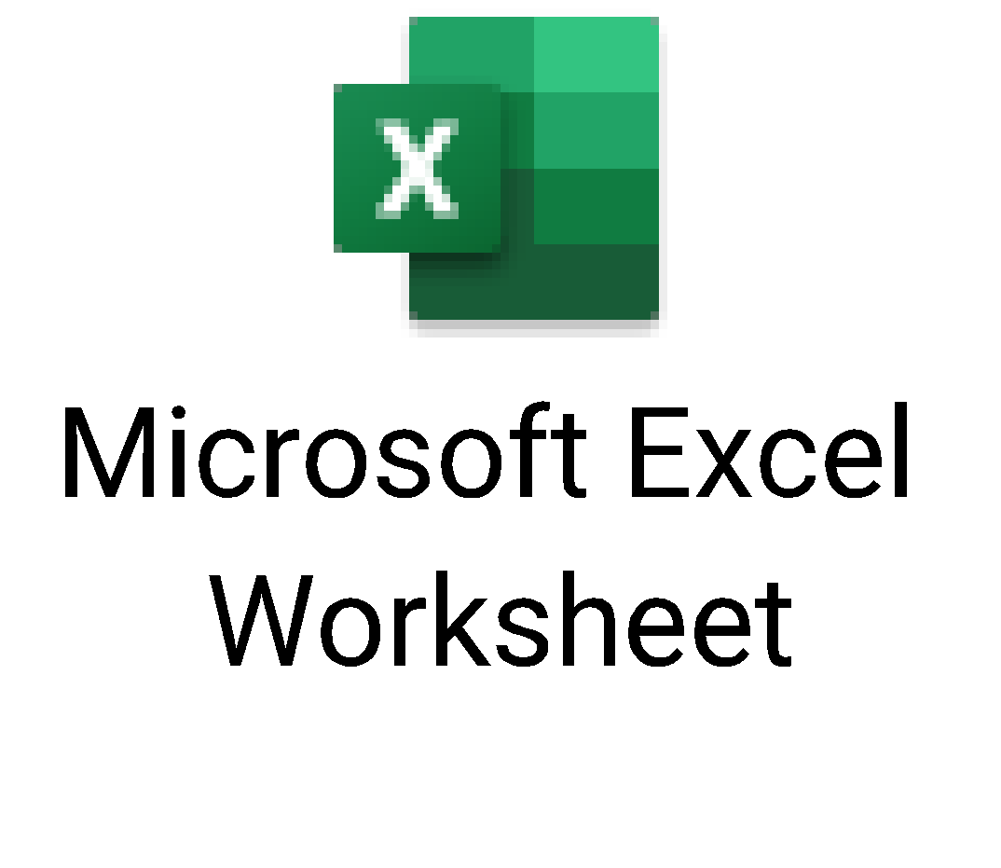
Data Collection and details
Data has been given by the client which is company's past data
Data gave by clients contains :
1. Billing date--billing occurred
2. Variant--variant of heavy equipment vehicle
3. Economic Index--external factor which measures economic health
4. Industry Growth Rate (%)---gives info about industry growing or declining
5. Seasonality Factor-- factor describing the seasonal affected the data (e.g., holidays, seasons).
Data given by the client

Slide 10
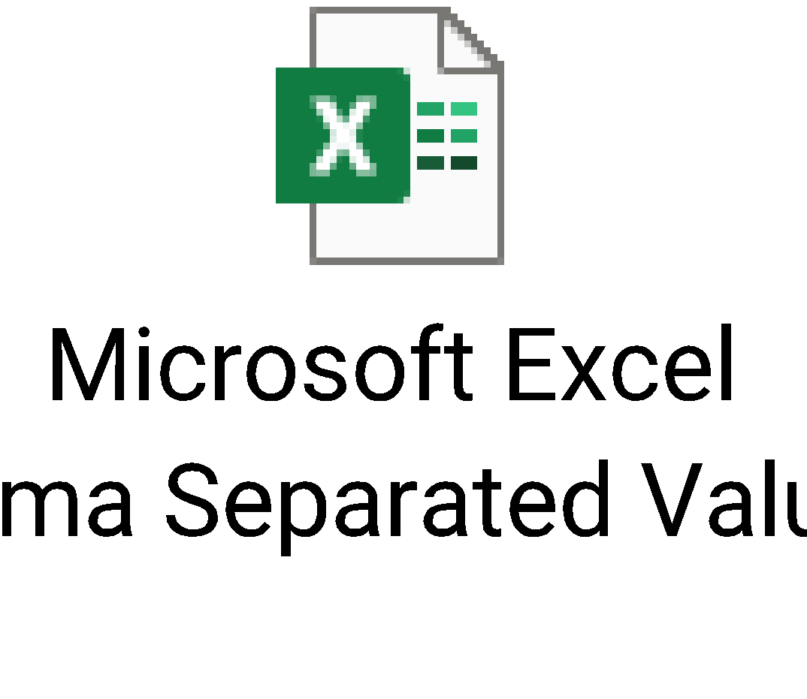
Data Collection and details
As the dataset is large we are unable to forecast on daily bases.
So, the dataset needed to convert into monthly or weekly data
Selected monthly data
Monthly dataset

Slide 11
Exploratory Data Analysis [EDA]
Statistical Insights
Business Insights
For both column there is positively skewed (right-skewed) and has high variance is due to a few extreme values (outliers)
The distribution is considerably skewed to the right indicating the presence of outliers or a natural long-tailed distribution and leptokurtic sharper peak around the mean.
The majority of the data points are concentrated on the left side (lower values) with a long tail extending to the right (higher values).
Contains High Extreme values which are away from mean.
No clear increasing or decreasing trend, indicating that the data is stationary in terms of its mean. Stationarity implies that properties like mean and variance should remain constant over time.
Economic index and industry growth rate have stationary data and has no random walk or heavy noise.
The spread of data shows some correlation, but it is not a perfect linear relationship, suggesting some non-linear patterns or possibly noise in the data.
There's a positive correlation between the Economic Index and Industry Growth Rate, as indicated by the upward trend.
Large frequency of low values and High variance means high flucations for both the columns.
Highly imbalanced data between high and lower values where data points towards left side values are higher and higher value (kurtosis) indicates higher outliers unpredictable growth or downfall may happen.
Most values are far to the average making forecasting and trend analysis more hard and Sudden change in values and highly unstable.
Identify trends and seasonality that are strongly effecting. Economic Index have strong influence on Industrial growth rate and vise versa.
By leveraging the stationary nature , businesses can make more informed decisions, enhancing their ability to navigate market conditions and plan for the future effectively.
Both variables are dependent on each other and also many factors are effecting them has there's a positive correlation between the Economic Index and Industry Growth Rate, as indicated by the upward trend.
Prioritize investments in industries with a higher Economic Index since they are more likely to exhibit higher growth rates. This can lead to better returns on investment and support long-term growth strategies.
Small improvements in these high-impact variants can lead to significant overall gains
Notes:
EDA is used for seeing what the data can tell us before the modeling task.
Change

Slide 12
Data Preprocessing
1. Converting data into monthly_data
2. Data cleaning --missing values and outliers
3. Exploratory Data Analysis (EDA)--Plot time series to check for trends, seasonality, or other patterns.
4. Stationarity Check--check if the time series is stationary by ADF test
5. Model building--forecast for two independent variables (Economic Index, Industry Growth Rate )For each variant
Notes:
Keep observations

Slide 13
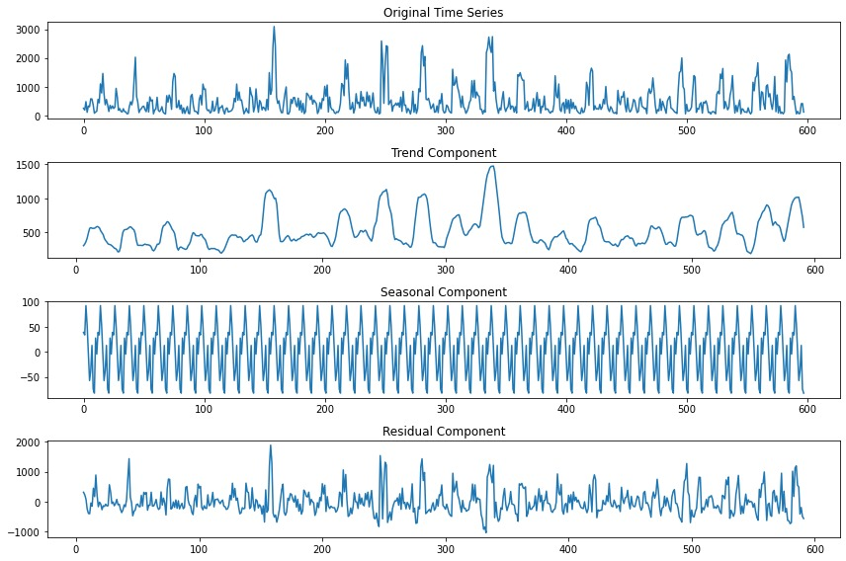
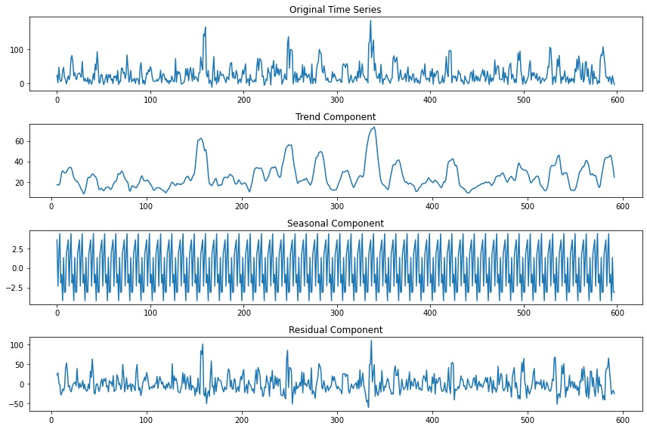
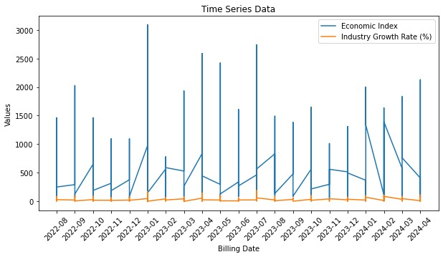
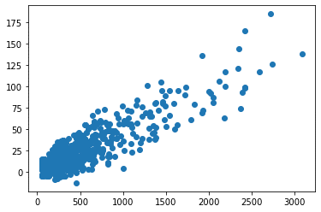
Data Visualization
Scatter plot between Economic Index and Industry Growth Rate
Economic Index
Industry Growth Rate

Slide 14
CRISP-ML(Q) Methodology There are six stages of CRISP-ML(Q) Methodology
1.Business and data understanding – In this initial stage, identify the goals and requirements of the project. Understand the company requirements, demands to increase the company revenue
2.Data preparation- Clean and preprocess the dataset to ensure consistency and quality. This may involve converting relevant column to datetime datatype, handling missing values, checking for stationarity, check for random walk. Preparing data for training.
3.Model building – Select appropriate machine learning algorithms suitable for ARIMA, AR(auto-regression), Moving Average, Linear regression, Xgboost. Train models for forecasting relevant variables in the data

Slide 15
CRISP-ML(Q) Methodology There are six stages of CRISP-ML(Q) Methodology
4.Model Evaluation-
Compare different models to identify the best-performing one for forecasting.
5.Model Deployment- Deploy the chosen model into a user-friendly application that allows forecasting the demand and ensuring client satisfaction on prediction for different variants of heavy vehicles.
6.Monitoring and Maintenance-
Continuously monitor the model's performance in real-world scenarios. Collect feedback from company and adjust the model as necessary to improve accuracy and relevance. Regularly update the model with new data ensuring it remains effective and reliable

Slide 16
Model Building
1.XGBoost (Extreme Gradient Boosting)
It is a powerful machine learning algorithm primarily used for supervised learning tasks such as regression and classification. Although it is not specifically designed for time series forecasting, it can be adapted to handle forecasting problems through feature engineering and careful data preparation.
Suitable for—XXX12, XXX13, XXX17
2. Linear Regression
Linear regression can be used for time series forecasting by transforming the data into a supervised learning format, where the past observations are used to predict future values. Although linear regression is relatively simple compared to other forecasting models, it can be effective for basic time series data, especially if the relationships are approximately linear.
Suitable for - XXX11, XXX15, XXX18, XXXV5, XXXV9
3. Simple Exponential Smoothing
is a popular and effective method for time series forecasting, especially when the data exhibits a consistent level (no trend or seasonality). It is used to predict future values based on weighted averages of past observations, where more recent observations are given higher weights.
Suitable for- XXXV1, XXXV2, XXXV3, XXXV4

Slide 17

Deployment
Streamlit: is an open-source framework for building interactive web applications using Python. It allows rapid development with a user-friendly interface and real-time interactivity through components like sliders and buttons. Streamlit seamlessly integrates with popular data science libraries, making it ideal for visualization and analysis.

Slide 18
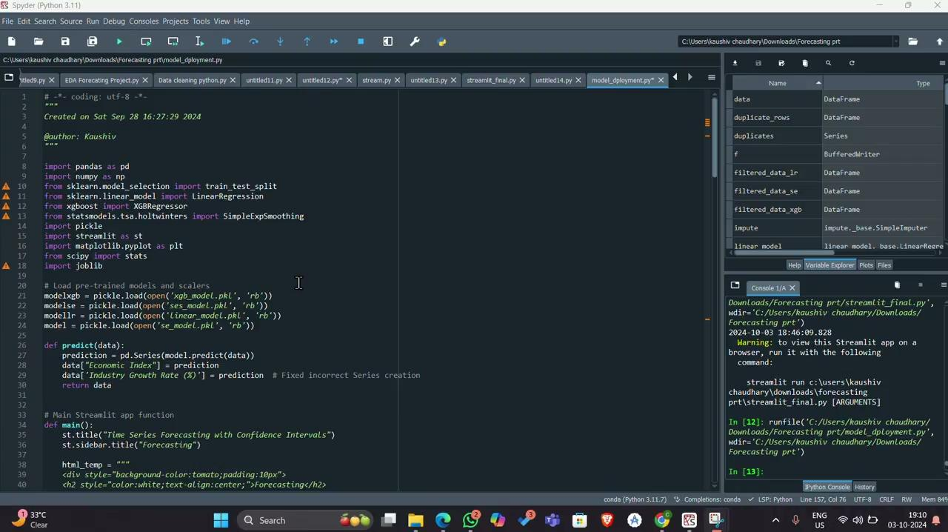
Deployment

Slide 19

Queries?

Slide 20


